Slide 1
FacePlay – Face, Gender and Emotion detection using OpenCV, Dlib and FisherFace
Group : CS-14
Under the guidance of :-
Dr. Dinesh Singh
29th November, 2018.
Deepak Bulani 20153026
Gaurav Agarwal 20154097
Bonthu Harsha Vardhan Reddy 20154148
Avichal Verma 20154085
Amit Ranjan 20154101

Slide 2
Outline of the Project
Motivation
OpenCV
Haar Classifier
Dlib Library
FisherFace Recognizer
Timeline of the project
Conclusion
References

Slide 3
Motivation for the Project
Facial recognition is an important topic in the fields of computer vision and artificial intelligence owing to its significant academic and commercial potential in fields like biometrics, surveillance system, information security and wearable technology.
We intend to employ standards of face recognition and emotion detection and create a real time way to find the emotions of the people interacting over a video call or through webcam.
As emotions is an underlying fabric in human communications, we can exploit the knowledge of emotions of people in desired circumstances like driving a car, talking to a relative, watching relevant ads on social websites and so on.

Slide 4
Face, Emotion and Gender Detection
The act of identifying or verifying a person from a digital image or a video frame. There are many different facial recognition techniques, most of them are based on different nodal points on a human face.
The physiological characteristics of the human face with relevance to various expressions such as happiness, sadness, fear, anger, afraid, surprise, neutral and disgust are associated with geometrical structures and can be detected using various facial landforms.
To build our face recognition system, we will first perform face detection, extract face embeddings from each face, train a face recognition model on the embeddings, and then finally recognize faces in images with OpenCV.

Slide 5
OpenCV
OpenCV is an open-source computer vision and machine learning software library created by Intel.
It has more than 2500 algorithms, which include both computer vision and machine learning.
These algorithm can be used to detect and recognize faces, identify objects, track camera movements, follow eye movements.
It is written in C++ language and supports variety of programming language like C++, Python and JAVA.

Slide 6
Haar Classifiers
Haar Cascade is a machine learning object detection algorithm used to identify objects in an image or video based on the concept of ​​ features.
Algorithm has three stages – Haar feature Selection, Adaboost training, Cascade of Classifiers.
Haar feature Selection - A Haar Feature considers adjacent rectangular regions at a specific location in a detection window, sums up the pixel intensities in each region and calculates the difference between these sums.
Adaboost Training – selects the best features(out of 160000+) and trains the classifiers that uses them. This algorithm constructs a “strong” classifier as a linear combination of weighted simple “weak” classifiers.

Slide 7
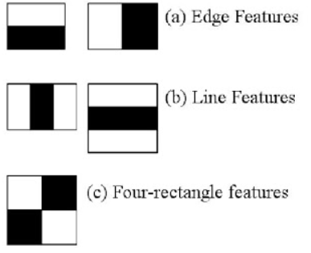
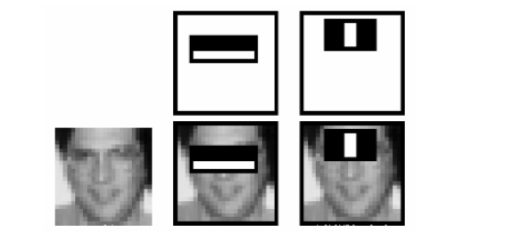
Haar Classifiers
Cascade of Classifiers - Instead of applying all Haar features on a window, the features are grouped into different stages of classifiers and applied one-by-one. If a window fails the first stage, discard it. We don’t consider the remaining features on it. If it passes, apply the second stage of features and continue the process. The window which passes all stages is a face region.
Haar Features In Action

Slide 8
Dlib Library
Dlib is a modern C++ toolkit containing machine learning algorithms and tools for creating complex software in C++ as well as supports numerous features like Numerical Algorithms, Image processing, threading, GUI’s, data compression and networking.
The facial landmark detector implemented inside dlib produces 68 (x, y)-coordinates that map to specific facial structures. These 68 point mappings were obtained by training a shape predictor on the labeled iBUG 300-W dataset.
We then compute a bounding box over the ROI and visualize the image using different transparent overlays with each facial landmark region highlighted with a different color.

Slide 9
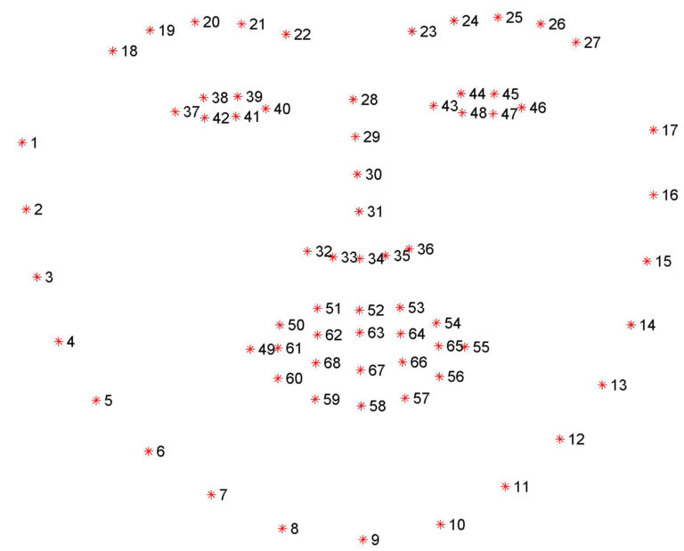
Below is the list of python indexes for accessing different facial regions. These mappings are encoded inside the FACIAL_LANDMARKS_IDXS dictionary inside face_utils of the imutils library.
The mouth can be accessed through points [48, 68].
The right eyebrow through points [17, 22].
The left eyebrow through points [22, 27].
The right eye using [36, 42].
The left eye with [42, 48].
The nose using [27, 35].
And the jaw via [0, 17].

Slide 10
FisherFace Recognizer
The Eigenface was the first method considered as a successful technique of face recognition. The Eigenface method uses Principal Component Analysis (PCA) to linearly project the image space to a low dimensional feature space.
The Fisherface method is an enhancement of the Eigenface method that it uses Fisher’s Linear Discriminant Analysis (FLDA or LDA) for the dimensionality reduction.
The LDA maximizes the ratio of between-class scatter to that of within-class scatter, therefore, it works better than PCA for purpose of discrimination. The Fisherface is especially useful when facial images have large variations in illumination and facial expression.

Slide 11
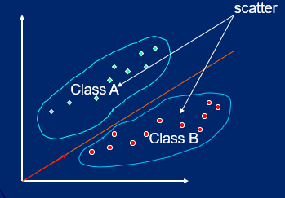
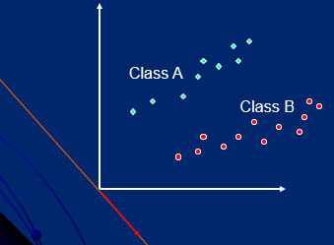
PCA seeks direction that are efficient for representing the data
LDA seeks directions that are efficient for discrimination between the data
PCA maximizes the total scatter
LDA maximizes the between-class scatter and minimizes within-class scatter

Slide 12
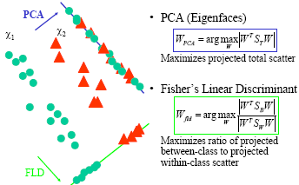
PCA & Fisher’s Linear Discriminant

Slide 13
Timeline of the Project
Face and eye detection using Haar classifiers provided under OpenCV
Performed face detection and extraction of facial regions using Dlib
Preprocessing of the IMDB-WIKI and KDEF datasets for gender and emotion detection
Training FisherFace using the above dataset and determining the model for gender and emotion detection
Obtaining accuracy after testing on the sample images
Performed gender and emotion detection using model obtained on test images as well as frames from video capture.

Slide 14
Face and eye detection using Haar classifiers
We will need to load the required XML classifiers .
We will use Haar Cascade Classifiers from OpenCV to identify different regions of the face.
We will take frames from the video input of webcam and convert into grayscale format for further analysis.
Use the function faceCascade.detectMultiScale() to obtain the coordinates enclosing the region of interest (ROI of the face).
Now for each different region of the face identified we will compute a bounding box of varying colors to differentiate among all the parts.

Slide 15
Face detection and extraction of facial regions using Dlib
Import the necessary packages and construct the argument parser to parse the arguments.
Initialize Dlib's face detector (Histogram Of Object Gradients :HOG-based) and then create the facial landmark predictor.
Load the input image, resize it, and convert it to grayscale and detect the faces in it.
Loop over the face parts individually from the face detections drawing the specific face part.
Extract the ROI of the face region as a separate image and show the particular face part
Visualize all facial landmarks with a transparent overlay.

Slide 16
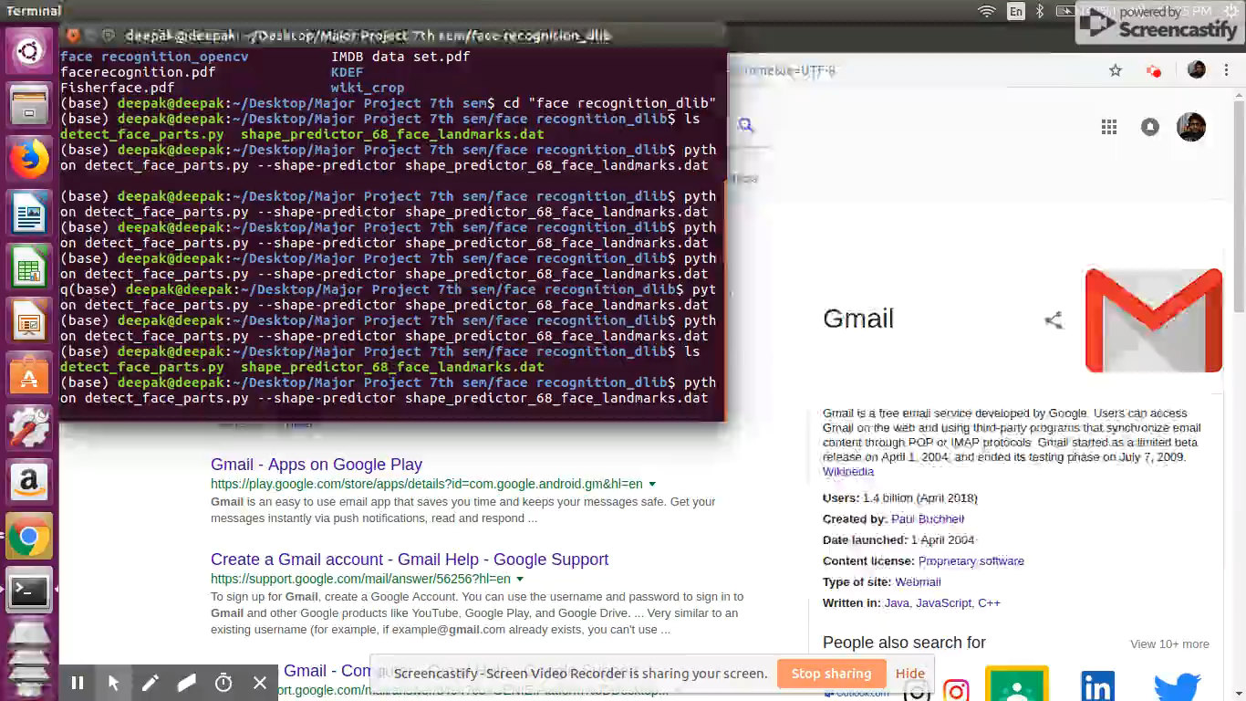
VIDEO

Slide 17
Preprocessing of IMDB-WIKI and KDEF Datasets
We train Fisherface Recognizer using images from KDEF(Karolinska Directed Emotional Faces) which contains images of 70 individuals each displaying 7 different emotions, each emotion being photographed(twice) from 5 different angles.
Also images from IMDB-WIKI dataset have been taken which is largest publicly available dataset of face images with gender and age labels for training. It contains 4,60,723 face images from 20,284 celebrities from IMDB and 62,328 from Wikipedia thus 5,23,051 in total.
Fisherface recognizer requires every training data to have the same pixel count. This raises a problem because the dataset from KDEF and IMDB does not have uniform size and thus produces error during training. To address this problem, emotion data prep.py and gender data prep.py are created. Both of them use face detection algorithm from face detection.py to detect faces in photos. Then, the picture would be normalized to uniform size (350px x 350px) and saved in grayscale to speed up the training process.

Slide 18
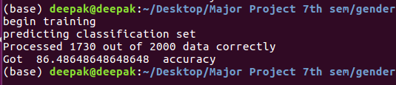
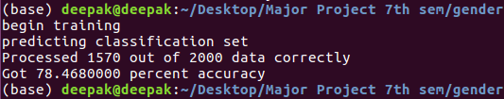
Training FisherFace and determining accuracy of Model
To train a model for emotion classier, put images of each of the 7 emotions mentioned in data/raw emotion/ . For example, put the images that show happy emotion in data/emotion/happy/ then, run:
python3 emotion data prep.py
python3 train emotion-classifier.py And similarly we will do it for gender as well.
Then we tested the model for accuracy against sample images to obtain the result as follows:
Fig 1: Accuracy of Gender Detection
Fig 2: Accuracy of Emotion Detection

Slide 19
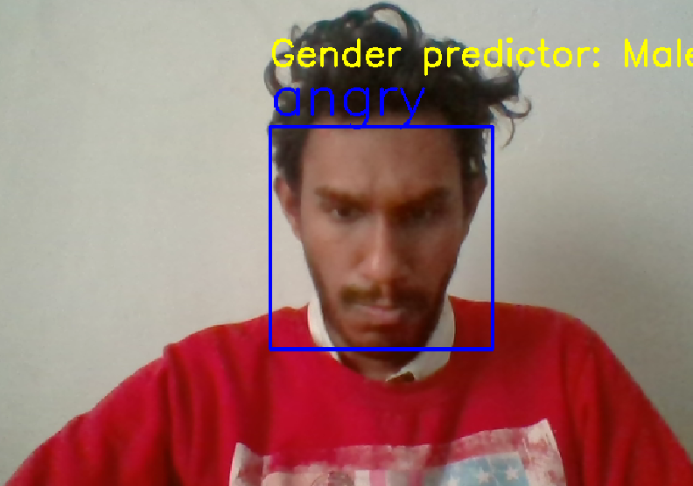
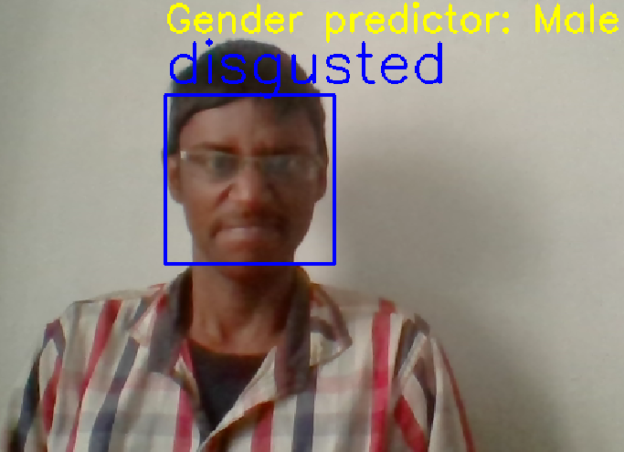
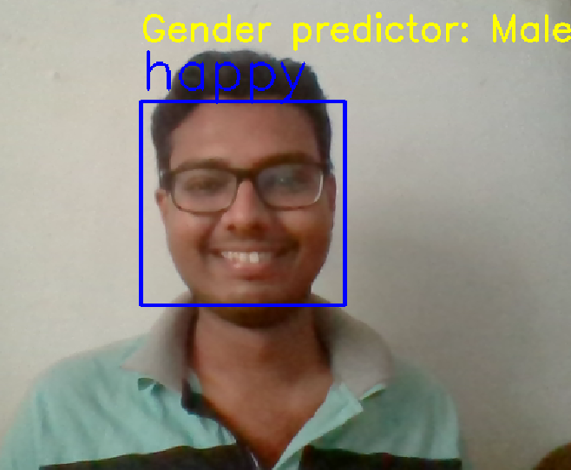
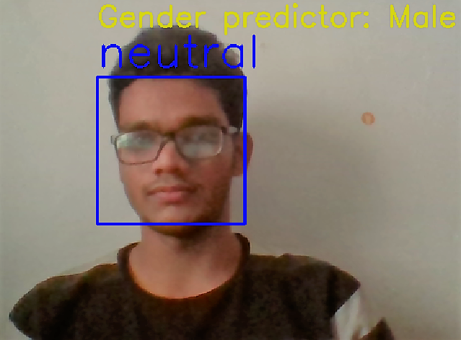
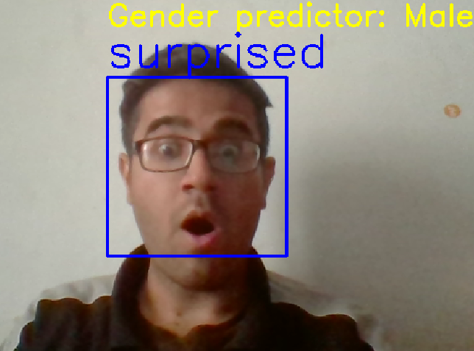
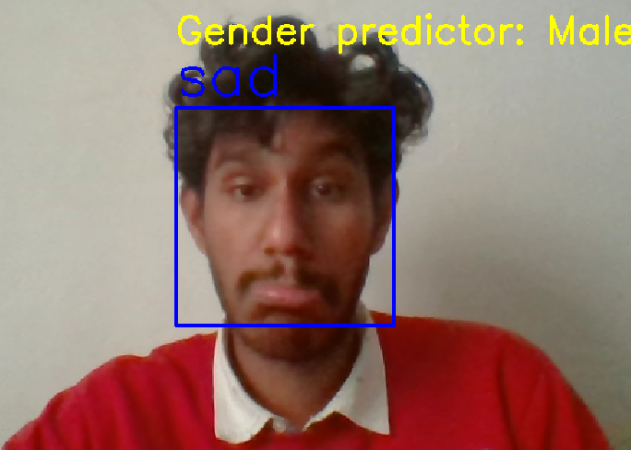
gender and emotion detection on real time feed from webcam

Slide 20
Conclusion
In this project we have performed face recognition using Haar classifier in OpenCV. For better efficiency we opted to use Dlib Library. The gender and emotion detection was performed utilizing FisherFace recognizer. We have also integrated our trained model with webcam to predict gender and emotion in real time. The overall accuracy achieved was 86.48% for gender detection and 78.46% for emotion detection.

Slide 21
References
Li Cuimei, Qi Zhiliang, Jia Nan,Wu Jianhua , "Human face detection algorithm via Haar cascade classier combined with three additional classiers" 2017 13th IEEE International Conference on Electronic Measurement Instruments (ICEMI).
Chung-Hua Chu and Yu-Kai Feng, Member of IEEE, "Study of Eye Blinking to Improve Face Recognition for Screen Unlock on Mobile Devices ," J Electr Eng Technol 2017.
KDEF dataset for emotion detection
http://www.emotionlab.se/kdef/
IMDB dataset for gender detection
https://data.vision.ee.ethz.ch/cvl/rrothe/imdb-wiki/

Slide 22
Thank You!

